Slide 1

Text-Based Depression Detection Using
PySS3
7th Sem
Project
Submitted By
Manish Kumar Sahu
20115055
CSE
Guided By
Dr. Jitendra Kumar Rout
Assistant professor
Department of CSE
Mayank Kurrey
20115057
CSE

Slide 2

Abstract
In the fast-paced online world, keeping an eye on mental health is crucial. Current systems struggle to detect early signs of depression on social media, making it a challenging task. Enter SS3, a cutting-edge solution that stands out for its transparency, adaptability to new information, and quick decision-making.
Project Goals
Early Depression Detection.
Improved Transparency.
Enhance Decision Making.

Slide 3

01
Motivation
02
Related Work
03
Proposed Model
Content
04
Model Working
30.11.2023
05
Optimization
06
Result and Comparison
07
Conclusion and Future Work

Slide 4

Cyber Impact on Mental Health
Negative Information
Online Harassment
Social Comparison and FOMO
Motivation
Need for Early Risk Detection
Timely Support
Enhanced Treatment
Normalizing Discussions
Challenges in Existing Models
Limited Transparency
Computational Efficiency
Limited Explainability

Slide 5
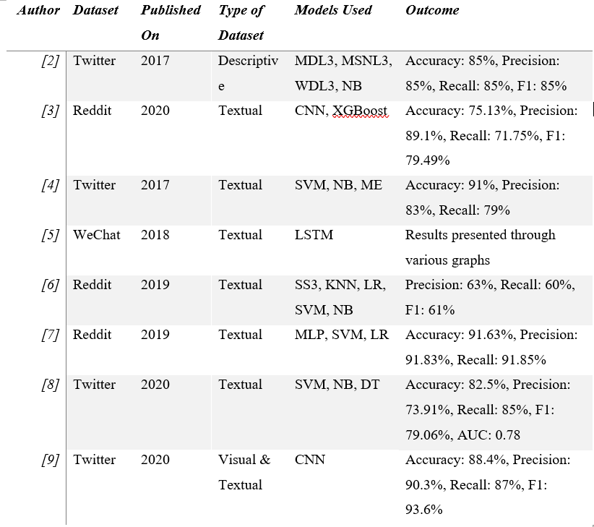
Related Work
The landscape of depression detection through text analysis has seen significant exploration, leveraging diverse datasets from prominent social media platforms. Various models have been employed, showcasing advancements in both descriptive and textual analyses. For instance, a Twitter dataset from 2017 utilized SVM, and NB models, achieving commendable accuracy and precision. In a Reddit textual dataset from 2020, the implementation of CNN and XGBoost demonstrated robust performance metrics.
MDL = Multimodal Depressive Dictionary Learning, WDL = Wasserstein Dictionary Learning, MSNL = Multiple Social Networking Learning

Slide 6




Proposed Model: SS3 Classifier
SS3, a state-of-the-art supervised learning model.
Ability to naturally explain its rationale.
White-box nature makes it explainable, and therefore more reliable
The name “SS3” is based on three hyperparameters: Sequential Smoothness-Significance-and-Sanction

Slide 7
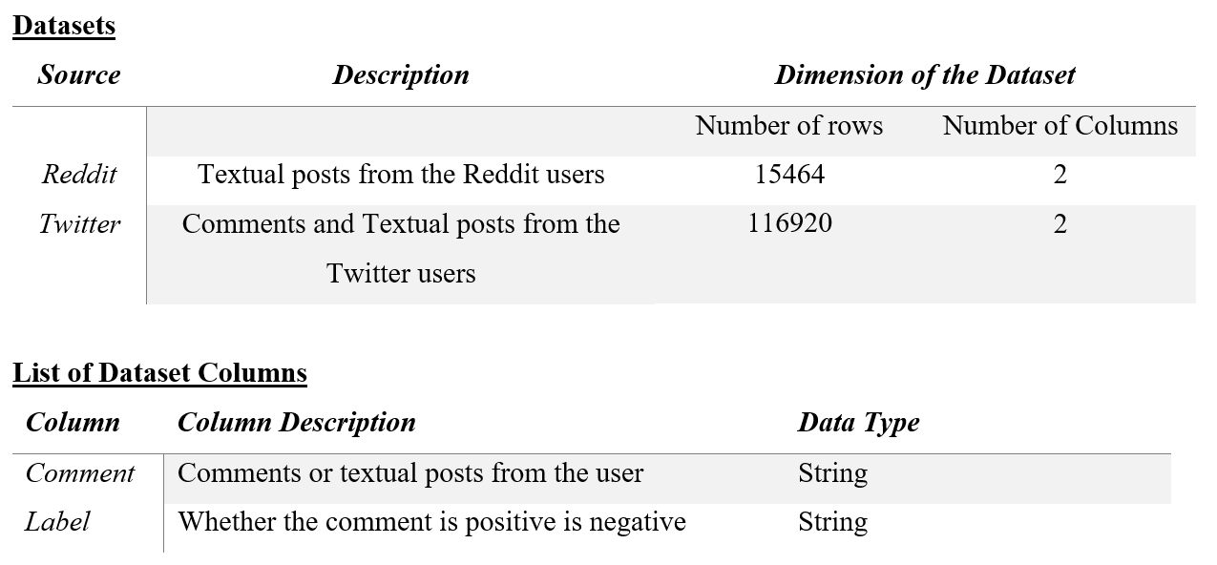
Textual Datasets from Social Media
The Dataset is split in the 80:20 ratio for training and testing purpose.

Slide 8
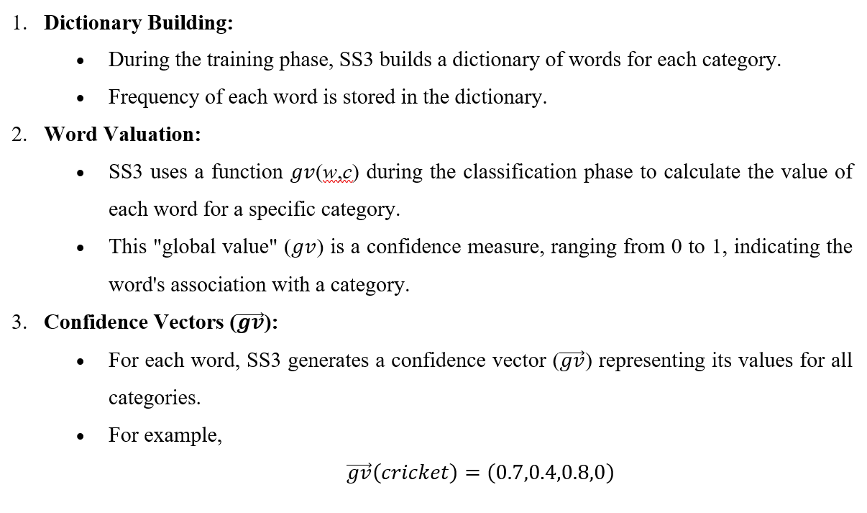
Working of SS3

Slide 9
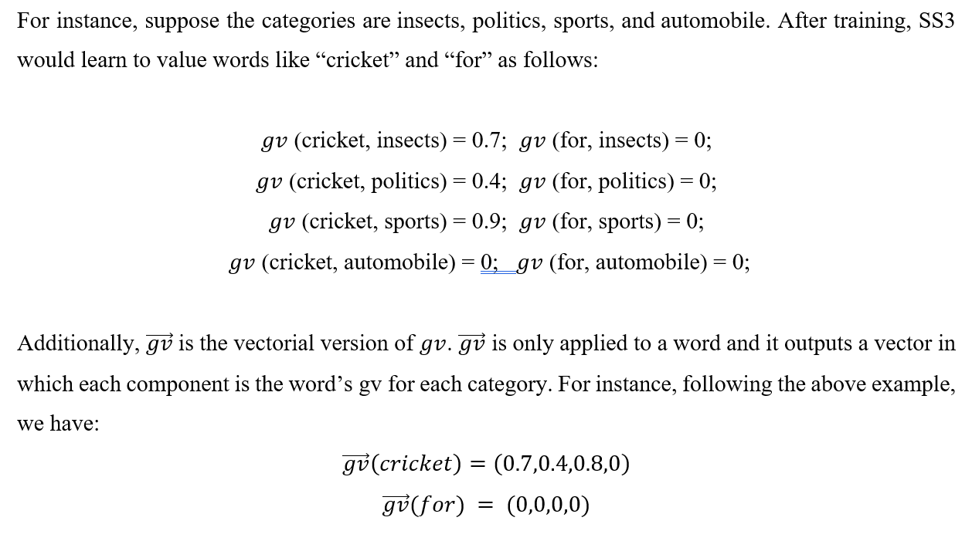
Working of PySS3

Slide 10
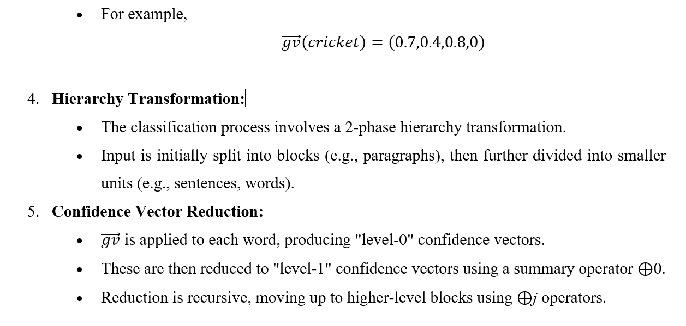
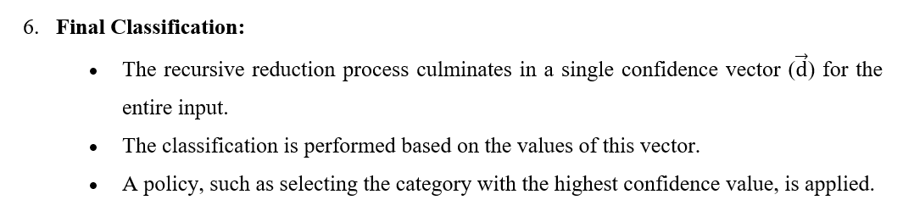
Working of PySS3

Slide 11
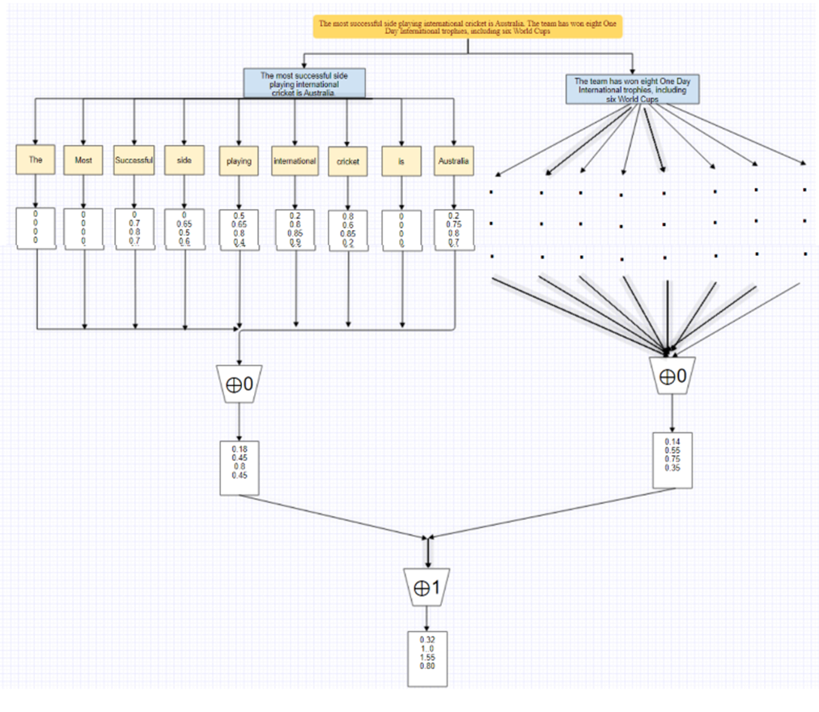

Slide 12
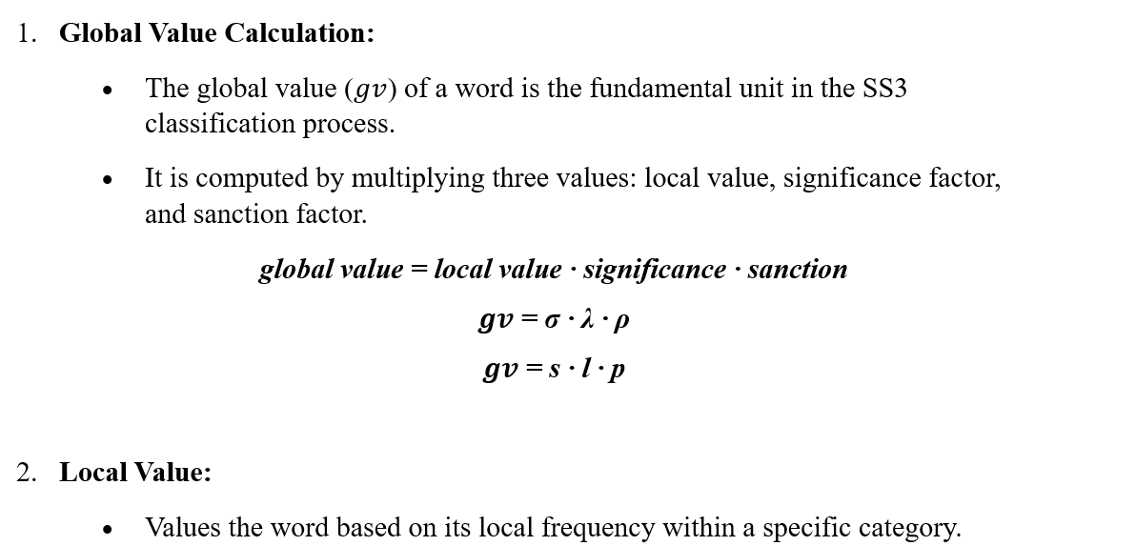
Hyperparameters

Slide 13
Hyperparameters
3. Smoothness Hyperparameter (σ):
Controls the smoothness of the relationship between raw frequency and the final local value.
Higher σ values make the local value more directly proportional to raw frequency.
4. Significance Factor:
Captures the global significance of the word by adjusting the global value relative to its local value in other categories.
Significance Hyperparameter (λ):
Controls how much the local value in a category must deviate from local values in other categories for the word to be considered important.
5. Sanction Factor:
Adjusts the global value based on the number of categories for which the word is significant.
Sanction Hyperparameter (ρ):
Controls the severity of the adjustment to the global value based on the number of significant categories.

Slide 14
SS3 Features
1. Transparency: SS3 provides a clear and interpretable rationale for its predictions.
Confidence vectors at different hierarchy levels allow users to understand the model's decision-making process.
2. Adaptability to Evolving Data Streams:
The incremental classification process allows for real-time updates with minimal reprocessing.
Ideal for applications where new data is continuously added, ensuring the model remains up-to-date.
3. Enhanced Computational Efficiency:
The use of confidence vectors and hierarchical processing optimizes computational efficiency.
Incremental classification, especially at higher levels, minimizes the need for reprocessing the entire dataset.
Suitable for large datasets and scenarios where computational resources are a consideration.

Slide 15
Live Test
Interactive Model Testing: The Live Test tool offers an interactive and user-friendly interface for actively testing SS3 models.
Testing Options: Users can manually test the model using either a preloaded set of documents or by typing in their own documents.
Visual Analysis: Enables users to visually analyze and understand what the model has learned at different levels, including word n-grams, sentences, and paragraphs.
Usability for Model Improvement: Enables users to iteratively test and refine the model based on visual feedback, contributing to continuous improvement.
Understanding Model Decisions: Users can observe and interpret how the model processes and classifies input documents in real-time.

Slide 16
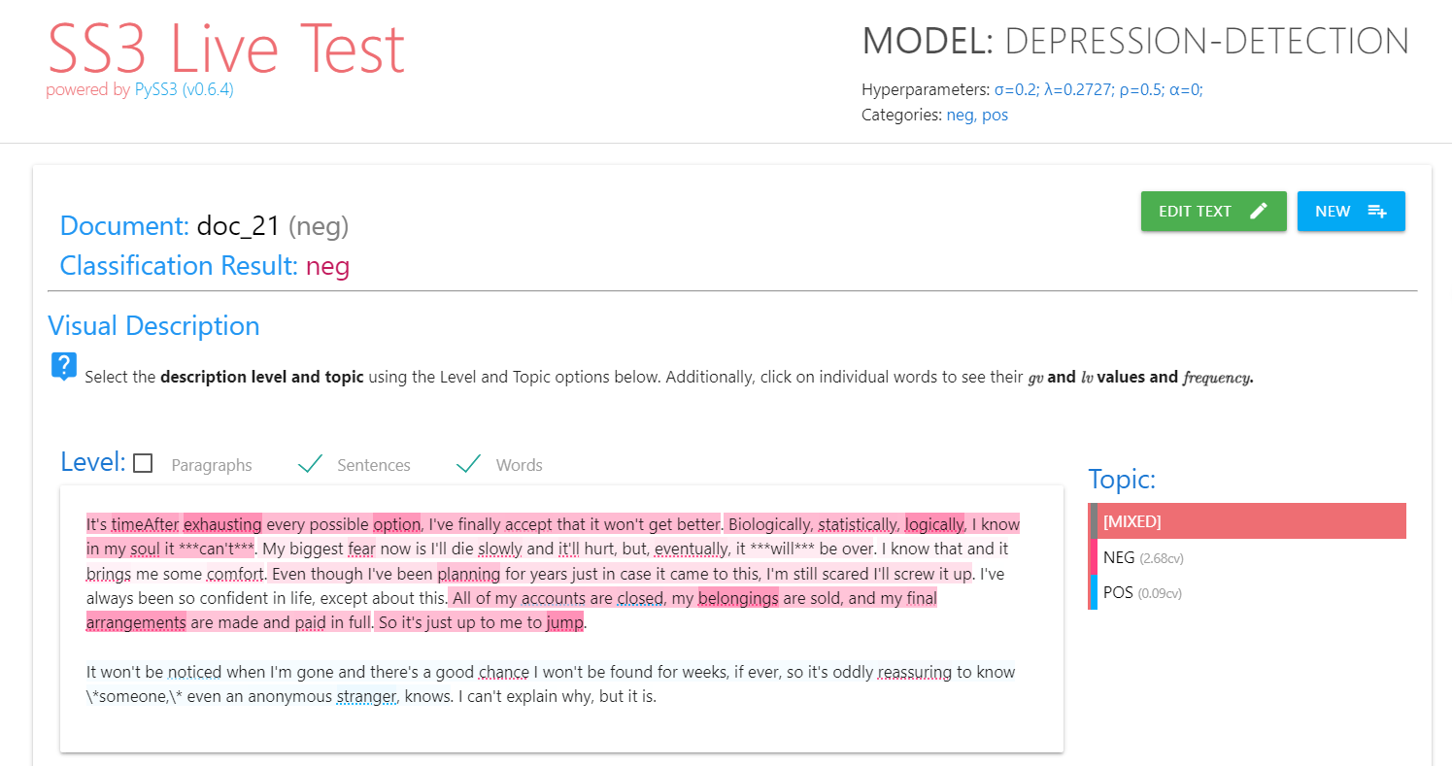

Slide 17
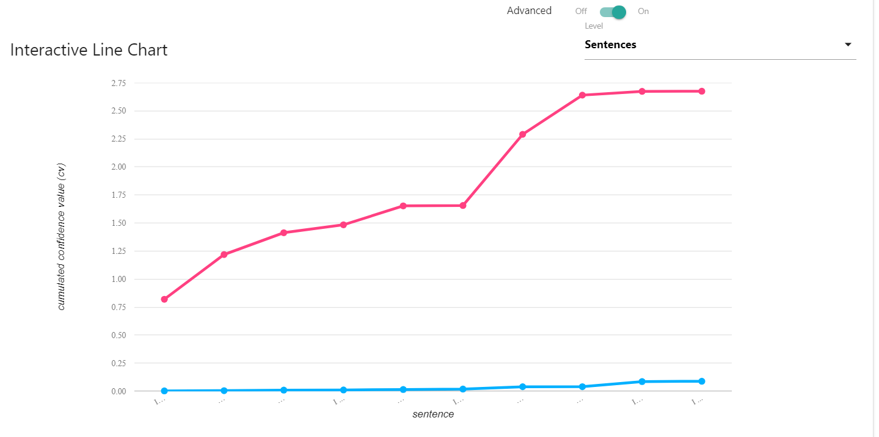

Slide 18
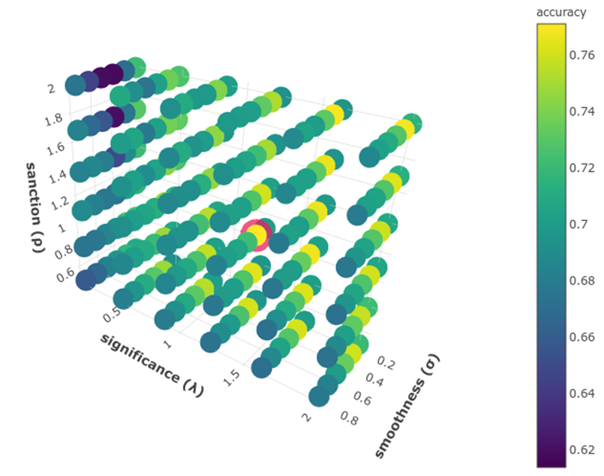
Hyperparameter Optimization
SS3 includes a plot representing the relationship between the three key hyperparameters: s, l, and p.
The plot illustrates the impact of different combinations of s, l, and p on the model's accuracy.
Each point on the plot corresponds to a specific set of hyperparameter values.
The point highlighted in pink on the plot represents the optimal combination of s, l, and p that yields the highest accuracy.

Slide 19
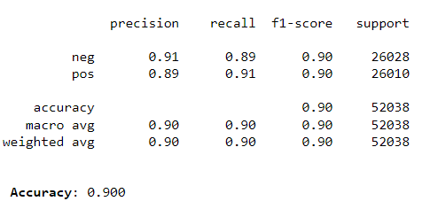
Results and Comparison
Displaying the confusion matrix provides a comprehensive view of the model's performance.
It presents a breakdown of true positives, true negatives, false positives, and false negatives.

Slide 20
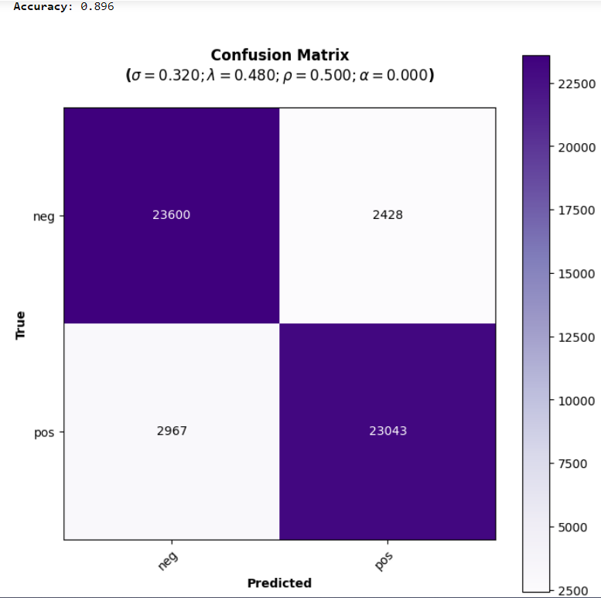
Results and Comparison
Displaying the confusion matrix provides a comprehensive view of the model's performance.
It presents a breakdown of true positives, true negatives, false positives, and false negatives.

Slide 21
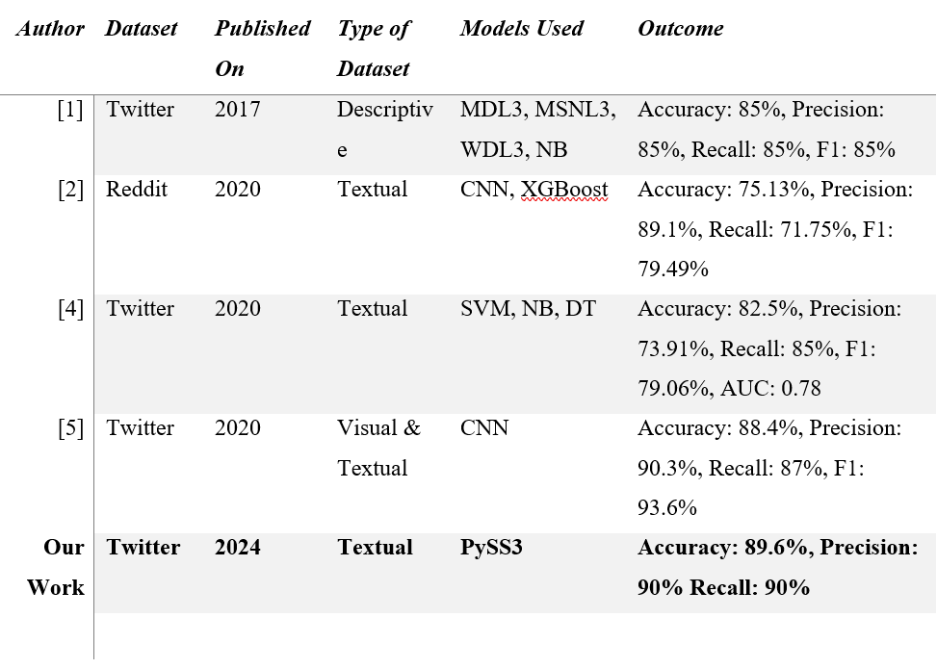
Results and Comparison

Slide 22
Conclusion
PySS3's Triumph:
This study showcased PySS3's exceptional performance in early depression detection from social media data.
Demonstrated PySS3's superiority over standard and state-of-the-art models, offering a promising solution for text classification.
Distinctive Features:
Emphasized the significance of comprehensive visualization tools in enhancing interpretability.
Interpretability and Trust:
PySS3's interpretability, facilitated by hyperparameter tuning and visualization, addresses concerns in sensitive applications.
Showcased how PySS3's justifiability enhances trustworthiness in real-world scenarios, particularly in mental health assessment.
Metric Affirmation:
Affirmed PySS3's effectiveness using standard evaluation metrics (accuracy, precision, recall, F1 score).
Stressed its unique ability to balance sensitivity and specificity, critical for early risk detection tasks.

Slide 23
Future Work
Collaboration with Mental Health Professionals:
Propose collaboration with mental health professionals to provide additional layers of support.
Scalability Enhancement:
Suggested evaluating and enhancing PySS3's scalability, ensuring its efficacy with large-scale datasets and dynamic information flows.
Acknowledged the importance of scalability for real-world applications.
Real-time Intervention:
Highlight the advantage of real-time detection through PySS3 to identify users expressing depressive sentiments on social media.
Purposeful Connection:
Propose the integration of PySS3 with popular social media platforms to offer support to individuals detected with depression.

Slide 24
Thank you!

